Slide 1
Basic methods for setting up models:
Difference Equations

Slide 2
Model development steps
Identify the question
Identify existing knowledge
Choose model structure
Choose modelling method
Model quantification
Model validation
Prediction and optimization
Decision making

Slide 3
Identify the question
Motives for modelling infectious diseases
Understand observed patterns and trends
Evaluate control strategies
Explore what happens if...?
Measles example:
What is most likely to happen if a single measles case is
introduced into a population of 100,000 susceptibles?
To keep it simple:
Over the short term (100 days)
No births or deaths

Slide 4
Identify existing knowledge
Collate existing knowledge in research papers, lab reports, existing modelling exercises...
Collect data on the demographic, epidemiological and biological characteristics of the infection and the population
Discuss review with experts
Measles example:
Measles is an infection that confers near permanent immunity
The pre-infectious period is 8 days
The duration of infectiousness is 7 days
Basic reproduction number (R₀) is 13

Slide 5
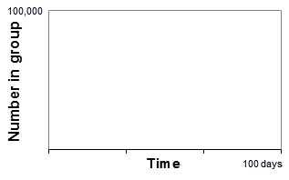
Identify existing knowledge
What happens to the number susceptible, infectious and immune, if we introduce a single infectious case into a population of 100,000 susceptibles?
Difficult to predict purely from available data, but we can try to write down the number of susceptible, infectious and immune individuals at some later time (tomorrow) in terms of what we know now (today)

Slide 6
Choose model structure
‘Models should be as simple as possible and no simpler’ by Einstein
Infection stages, transitions, population groups to be described to address the research question
Accuracy of model prediction
- how accurate your estimates need to be when compared to the time period that individuals spend in each of the categories
- subgroups: to predict the number of cases by age, the population need to be split by age
- to describe the long-term dynamics, the model need to incorporate births, deaths, possibly seasonal mixing patterns and migration
Notes:
In choosing the structure of your model, the infection categories and transitions need to be described as well as important categories in the population itself.
At this stage, it also useful to consider the format of model output to ensure that it can be compared to available data to test and validate the model later on.
The model population may also need to be split into various subgroups. In the extreme, models can be set up to model each person individually (so called ‘individual-based’ models).

Slide 7
Choose model structure
SI
Susceptible
Infectious
Infectious
stage
Infectious
transition
SIS
Susceptible
Infectious
SIR
Susceptible
Infectious
Removed/Immune
SIRS
Susceptible
Infectious
Removed/Immune

Slide 8
Choose model structure
SEIR
Susceptible
Pre-Infectious
Infectious
Removed/Immune
SEIRS
Susceptible
Pre-Infectious
Infectious
Removed/Immune
Which is most appropriate model structure
to answer our measles question?
Notes:
For example, if the estimates need to be accurate to the nearest day, then as the preinfectious period for measles is long on this time scale (8 days). In this case the SEIR design may be the most appropriate.
Alternatively, if they need to be accurate to the nearest month, the SIR design may be adequate, given that newly infected individuals can be infectious within 8 days, which is much less than a month.
As the objective of our measles exercise is very simple to forecast only the short-term dynamics in a population, we can assume random mixing, no seasonal variation and no age dependencies.

Slide 9
Choose modelling method
Stochastic or deterministic models
Stochastic models
Stochastic equations incorporate chance fluctuations and provide a range of outcomes per scenario
Many ‘runs’ required and ‘Runs’ averaged to give most likely outcome for scenario, along with a range of variability
Used where
- chance fluctuations are important e.g. small isolated populations, start or end of epidemic
- information on the variability of the outcome is as important as average outcome

Slide 10
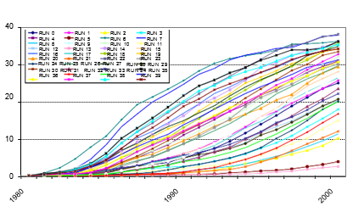
Stochastic modelling
HIV Prevalence (%) by year, 40 runs

Slide 11
Deterministic modelling
Deterministic models
Deterministic equations describe what happens on average and do not incorporate chance fluctuations
Provides only one outcome per scenario
Transitions rates are average transition rates for population
Most deterministic models are compartmental models in which population divided into small number of subgroups (compartments)
Don’t confuse modelling method (stochastic vs. deterministic) with ‘granularity’ of model structure (compartmental vs. individual-level)

Slide 12
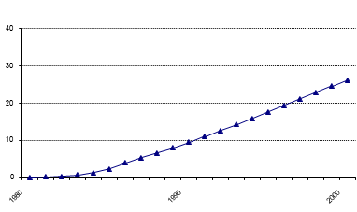
Deterministic modelling
We want to find out (only)
what is most likely to happen.
Stochastic or deterministic?
HIV Prevalence (%) by year

Slide 13





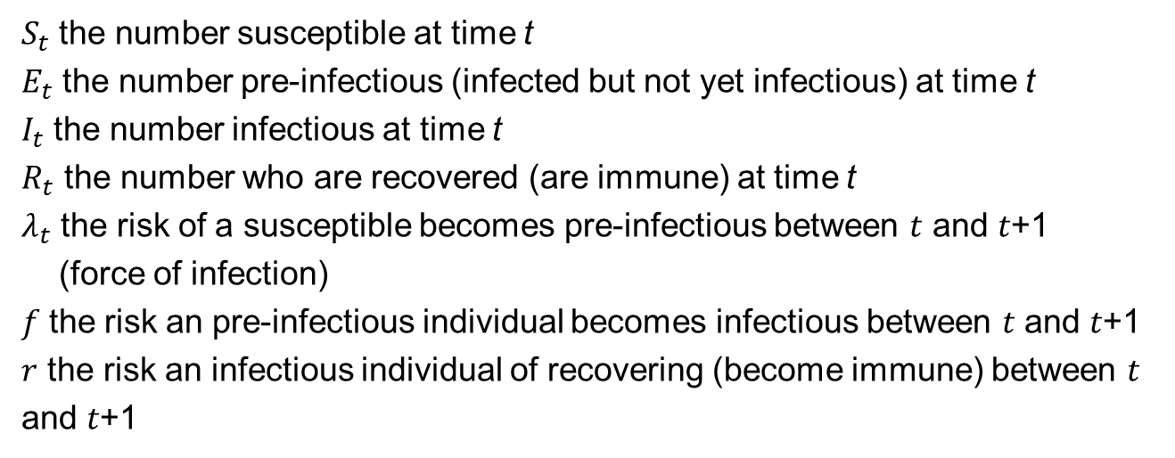


The difference equations for measles model
Susceptible
Pre-Infectious
Infectious
Removed/Immune
$$λ_{t}$$
$$f$$
$$r$$
$$S_{t}$$
$$E_{t}$$
$$I_{t}$$
$$R_{t}$$
$S_{t}$ the number susceptible at time t
$E_{t}$ the number pre-infectious (infected but not yet infectious) at time t
$I_{t}$ the number infectious at time t
$R_{t}$ the number who are recovered (are immune) at time t
${\text{λ}}_{t}$ the risk of a susceptible becomes pre-infectious between 𝑡 and 𝑡+1
(force of infection)
𝑓 the risk an pre-infectious individual becomes infectious between 𝑡 and 𝑡+1
$r$ the risk an infectious individual of recovering (become immune) between 𝑡 and 𝑡+1
Notes:
Difference equations aim to describe the transitions between different disease categories using discrete time steps (daily, for example)
by expressing the number of cases at a given time t+1 (tomorrow, for example), in terms of that at an earlier time t, (e.g. today).

Slide 14











The difference equations for measles model
$$λ_{t}$$
$$f$$
$$r$$
$$S_{t}$$
$$E_{t}$$
$$I_{t}$$
$$R_{t}$$
$$S_{t+1}=S_{t} − λ_{t} ∗S_{t}$$
$$E_{t+1}=E_{t}+ λ_{t} ∗S_{t} −f ∗E_{t}$$
$$I_{t+1}=I_{t} + f ∗E_{t} −r ∗I_{t}$$
$$R_{t+1}=R_{t}+r ∗I_{t}$$
These equations provide a good method for predicting the numbers of individuals who are susceptible, pre-infectious, infectious and immune over time.
The reliability of the difference equation method depends on the time step.
Notes:
The number who are susceptible at time t+1 = the number who were susceptible at time t - the number newly infected between time t and t+1
The number newly infected between time t and t+1 = product of the risk of infection per unit time (the force of infection) λt and the number at risk of becoming infected St
The number in the pre-infectious category at time t+1 =the number who were in the pre-infectious category at time t
+ the number newly infected between time t and t+1 - the number who became infectious between time t and t+1
The number who are infectious at time t+1 = the number who were infectious at time t
+ the number who became infectious between time t and t+1 - the number who recovered (became immune) between time t and t+1
The number of individuals who are immune at the time t+1 = the number who were immune at time t + the number who became immune between time t and t+1
To predict what happens when we introduce one infectious case, we simply calculate these equations when t=1 (today), t=2 (tomorrow). This is called solving the equations.
More reliable estimates may then be obtained using smaller time steps and taken to the limit, the differential equation approach describes the transmission dynamics in “continuous time”.

Slide 15
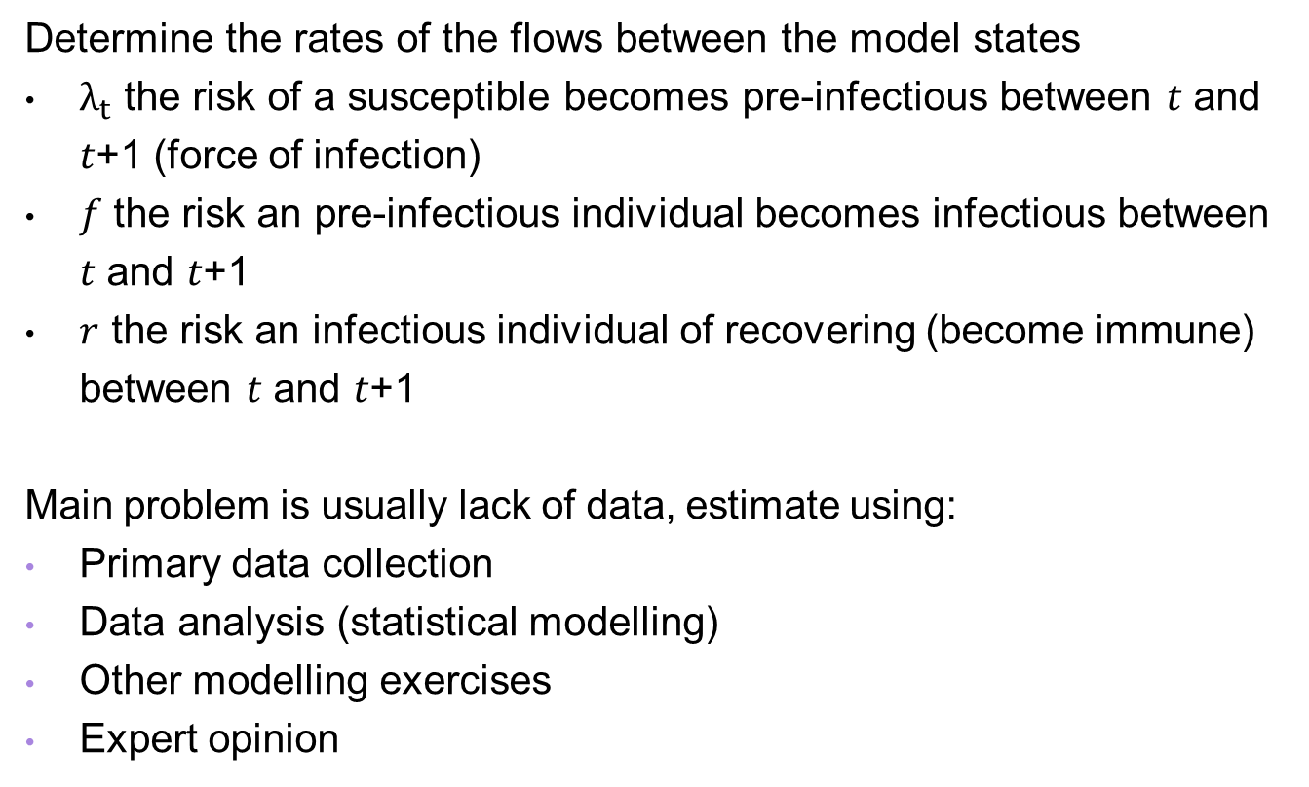
Model quantification
Determine the rates of the flows between the model states
$λ_{t}$ the risk of a susceptible becomes pre-infectious between 𝑡 and 𝑡+1 (force of infection)
𝑓 the risk an pre-infectious individual becomes infectious between 𝑡 and 𝑡+1
$r$ the risk an infectious individual of recovering (become immune) between 𝑡 and 𝑡+1
Main problem is usually lack of data, estimate using:
Primary data collection
Data analysis (statistical modelling)
Other modelling exercises
Expert opinion

Slide 16


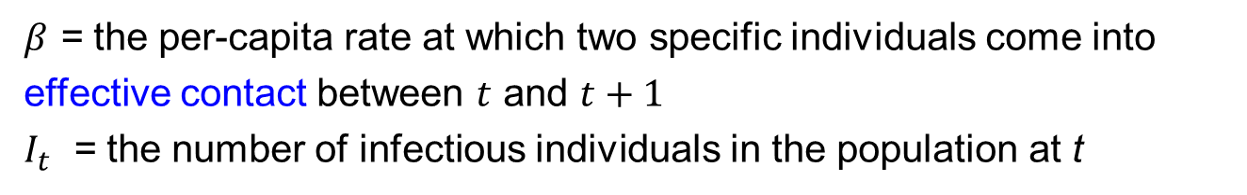
The force of infection $λ_{t}$
Risk of infection depends on the number of infectious individuals in the population and on the rate at which the susceptible individual comes into effective contact with an infectious individual.
Random mixing assumption: mass action principle
$$λ_{t}= β ∗I_{t}$$
A contact that would lead to infection if it occurs between a susceptible and an infectious person
$β$ = the per-capita rate at which two specific individuals come into effective contact between $t$ and $t+1$
$I_{t}$ = the number of infectious individuals in the population at t
Notes:
An effective contact is defined, as by Abbey (1952), as one sufficient to lead to infection if it occurs between a susceptible and an infectious individual.

Slide 17



Transmission rate $β$
To estimate $β$ we use relationship:
$β$= C_{e} / N and R₀ = C_{e} D → R₀ = $β$ND
R₀ = the number of secondary infections that would result from the
introduction of an infectious case into a completely susceptible
population (Basic reproduction number)
C_{e} = the total number effective contacts of each person, in each day
D = the duration of infectiousness, in days
N = population size

Slide 18

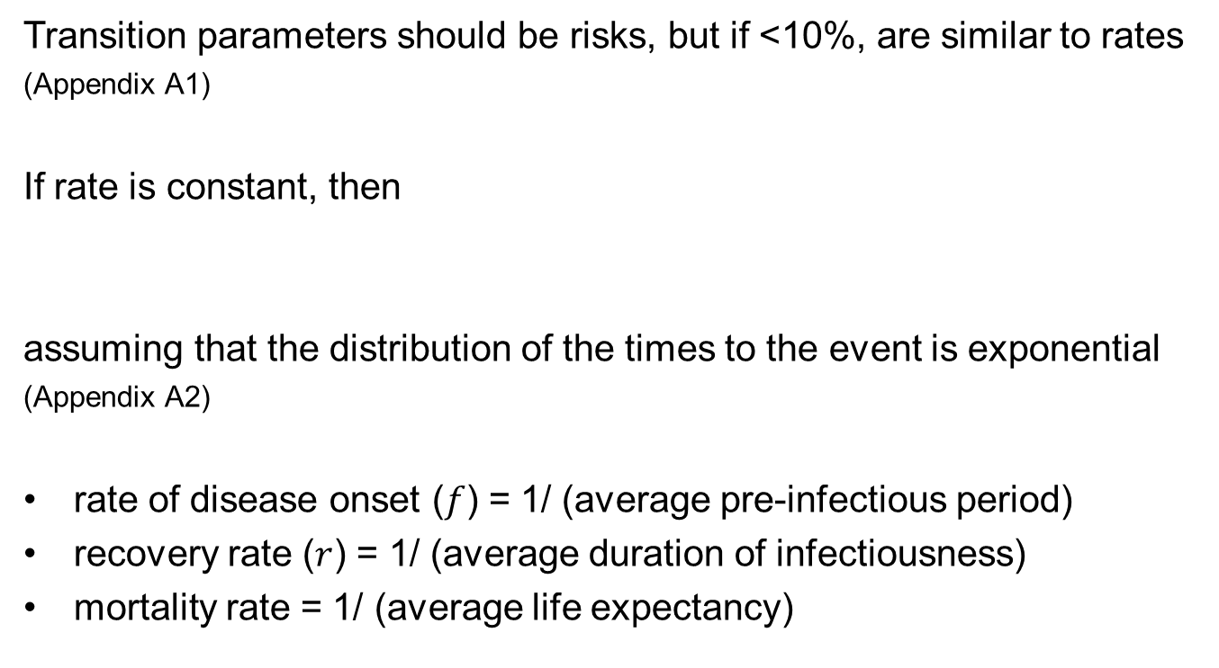
Transition parameters $f$, $r$
Transition parameters should be risks, but if <10%, are similar to rates
(Appendix A1)
If rate is constant, then
assuming that the distribution of the times to the event is exponential
(Appendix A2)
rate of disease onset ($f$) = 1/ (average pre-infectious period)
recovery rate ($r$) = 1/ (average duration of infectiousness)
mortality rate = 1/ (average life expectancy)
average rate at which the event occurs =1/ (average time to event)

Slide 19
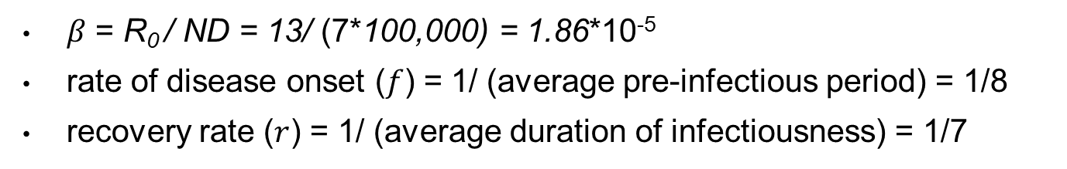
Model quantification-measles example
Measles example:
The population is 100,000
The pre-infectious period is 8 days
The duration of infectiousness is 7 days
Basic reproduction number (R0) is 13
𝛽 = R₀ / ND = 13/ (7*100,000) = 1.86*10⁻⁵
rate of disease onset ($f$) = 1/ (average pre-infectious period) = 1/8
recovery rate ($r$) = 1/ (average duration of infectiousness) = 1/7

Slide 20
Model validation
Check outputs against independent data sets
Daily numbers of cases reported
Seroprevalence of infection
Cumulative confirmed cases of COVID-19
Age-specific VZV seroprevalence data

Slide 21
Prediction and optimization
Prediction will depend on the model assumptions
→ Use sensitivity analysis of input parameter
The net reproduction number of COVID-19
The impact of timing of the second dose of varicella vaccine on the cumulative number of varicella cases
Notes:
The impact of timing of the second dose of varicella vaccine on the cumulative number of varicella cases until 25 years of age based on birth cohort, according to the base vaccine effectiveness.

Slide 22

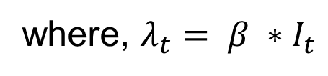










Remember
$$λ_{t}$$
$$f$$
$$r$$
$$S_{t}$$
$$E_{t}$$
$$I_{t}$$
$$R_{t}$$
$$S_{t+1}=S_{t} − λ_{t} ∗S_{t}$$
$$E_{t+1}=E_{t}+ λ_{t} ∗S_{t} −f ∗E_{t}$$
$$I_{t+1}=I_{t} + f ∗E_{t} −r ∗I_{t}$$
$$R_{t+1}=R_{t}+r ∗I_{t}$$
where, $λ_{t}= β ∗I_{t}$

Slide 23
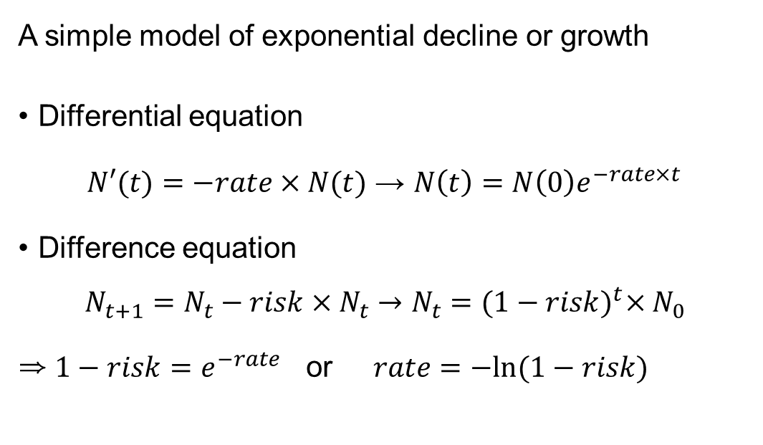
A1: Relation between risks and rates
A simple model of exponential decline or growth
Differential equation
$N′(t)=−rate×N(t)$ → $N\left(t\right)=N\left(0\right)e^{−rate×t}$
Difference equation
$$N_{t+1}=N_{t}−risk×N_{t}→N_{t}={(1−risk)}^{t}×N_{0}$$
⇒ $1−risk=e^{−rate}$ or $rate=−ln⁡(1−risk)$

Slide 24
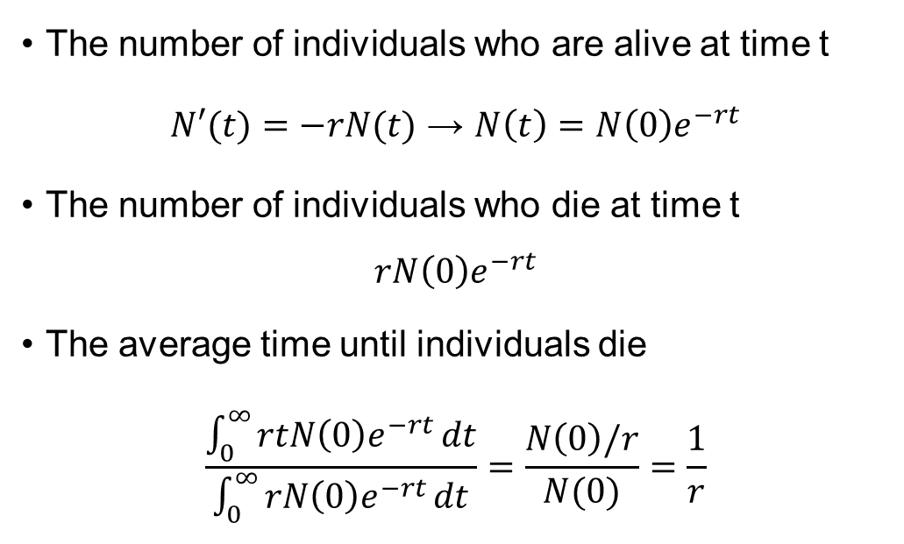
A2: Average life expectancy = 1/ mortality rate
The number of individuals who are alive at time t
$N′(t)=−rN(t)$ → $N\left(t\right)=N\left(0\right)e^{−rt}$
The number of individuals who die at time t
$$rN\left(0\right)e^{−rt}$$
The average time until individuals die
$$\frac{\int_{0}^{∞}{rtN\left(0\right)e^{−rt}}dt}{\int_{0}^{∞}{rN\left(0\right)e^{−rt}}dt}=\frac{N\left(0\right)/r}{N(0)}=\frac{1}{r}$$

Slide 25
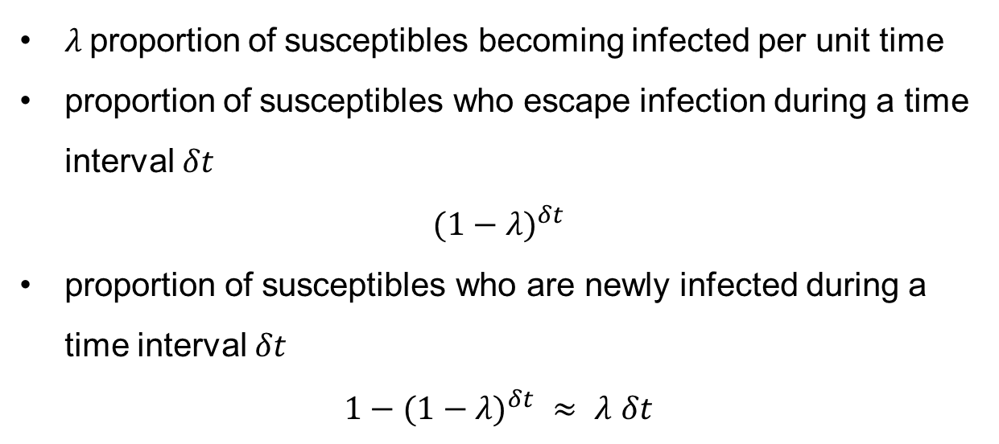
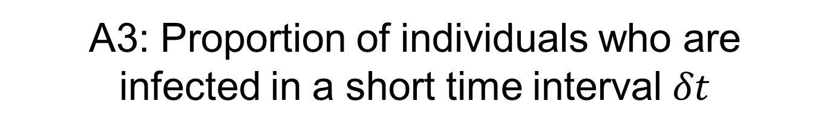
A3: Proportion of individuals who are infected in a short time interval $δt$
$λ$proportion of susceptibles becoming infected per unit time
proportion of susceptibles who escape infection during a time interval $δt$
$${(1−λ)}^{δt }$$
proportion of susceptibles who are newly infected during a time interval $δt$
${1−(1−λ)}^{δt }≈ λ$ $δt$

